Slide 1
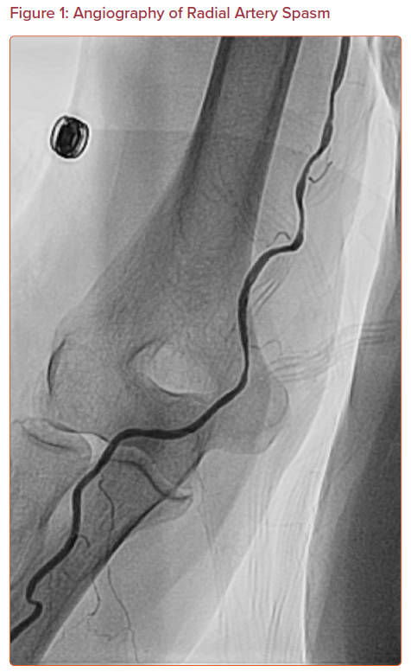
Riangwiwat T, Blankenship JC
Angiography of Radial Artery Spasm
Citation: US Cardiology Review 2021;15:e04.
https://doi.org/10.15420/usc.2020.23

