Slide 1
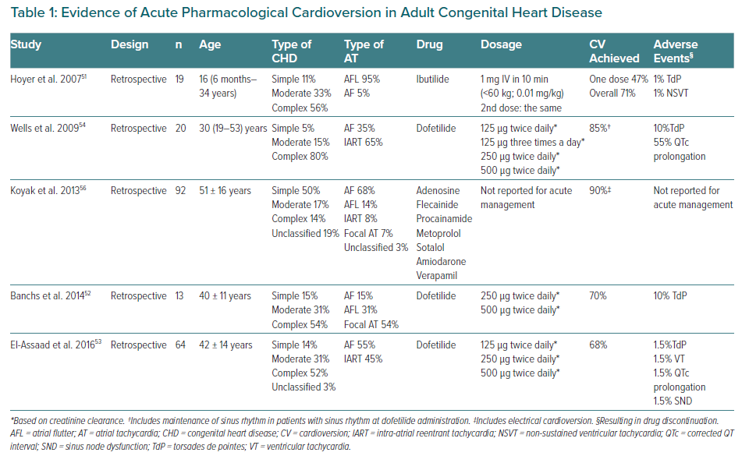
Martín de Miguel I, Ávila P
Evidence of Acute Pharmacological Cardioversion in Adult Congenital Heart Disease
Citation: European Cardiology Review 2021;16:e06.
https://doi.org/10.15420/ecr.2020.41

