Slide 1
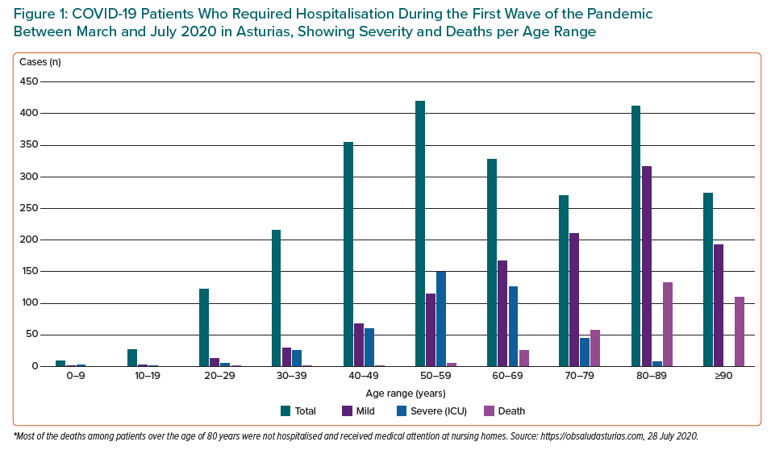
Coto E, Avanzas P, Gómez J
COVID-19 Patients Who Required Hospitalisation During the First Wave of the Pandemic Between March and July 2020 in Asturias, Showing Severity and Deaths per Age Range
Citation: European Cardiology Review 2021;16:e07.
https://doi.org/10.15420/ecr.2020.30

