Slide 1
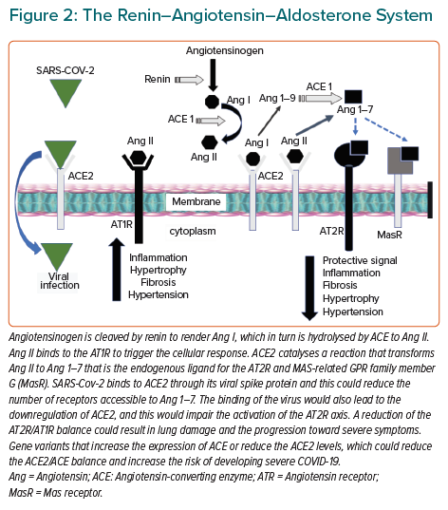
Coto E, Avanzas P, Gómez J
The Renin–Angiotensin–Aldosterone System
Citation: European Cardiology Review 2021;16:e07.
https://doi.org/10.15420/ecr.2020.30

