Slide 1
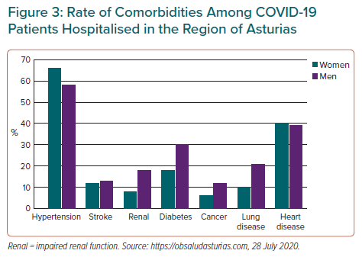
Coto E, Avanzas P, Gómez J
Rate of Comorbidities Among COVID-19 Patients Hospitalised in the Region of Asturias
Citation: European Cardiology Review 2021;16:e07.
https://doi.org/10.15420/ecr.2020.30

