Slide 1
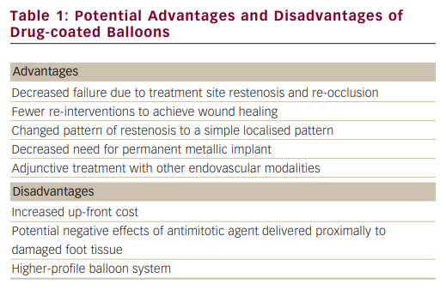
Ansel GM, Schneider PA
Potential Advantages and Disadvantages of Drug-coated Balloons
Citation: Interventional Cardiology 2012;7(1):63–5
https://doi.org/10.15420/icr.2012.7.1.63

