Slide 1

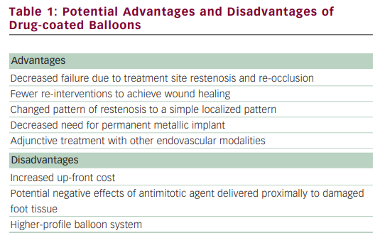
Ansel GM, Schneider PA
Potential Advantages and Disadvantages of Drug-coated Balloons
Citation: US Cardiology, 2012;9(2):112–4
https://doi.org/10.15420/usc.2012.9.2.112

