Slide 1
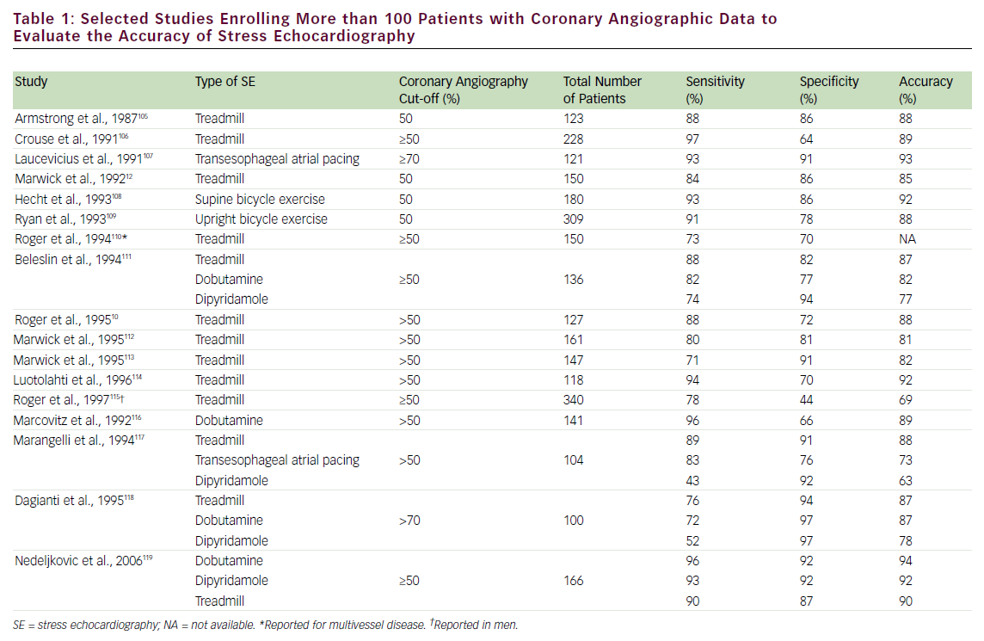
Abdelmoneim SS, Mulvagh SL
Selected Studies Enrolling More than 100 Patients
Citation: US Cardiology 2009;6(2):16–26
https://doi.org/10.15420/usc.2009.6.2.16

