Slide 1

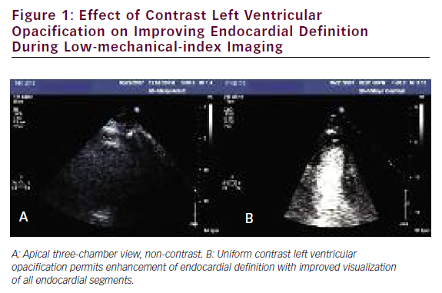
Abdelmoneim SS, Mulvagh SL
Effect of Contrast Left Ventricular Opacification
Citation: US Cardiology 2009;6(2):16–26
https://doi.org/10.15420/usc.2009.6.2.16

