Slide 1
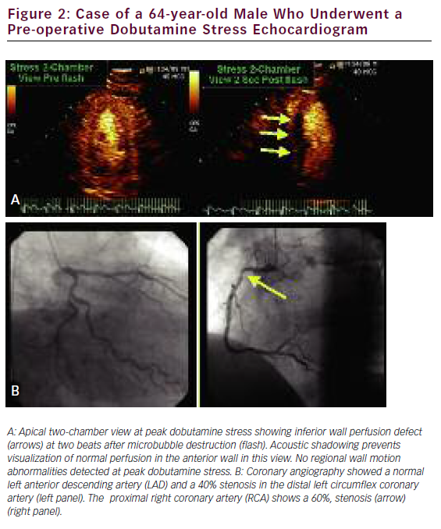
Abdelmoneim SS, Mulvagh SL
Case of a 64-year-old Male Who Underwent
Citation: US Cardiology 2009;6(2):16–26
https://doi.org/10.15420/usc.2009.6.2.16

