Slide 1
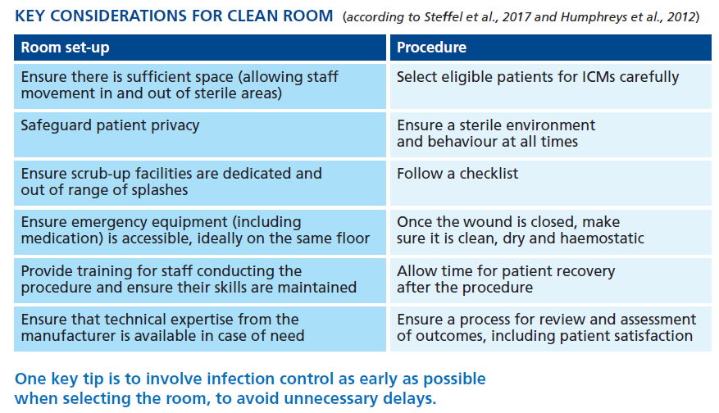
Cunningham N, Patwala A
Implanting the device
Citation:

