Slide 1

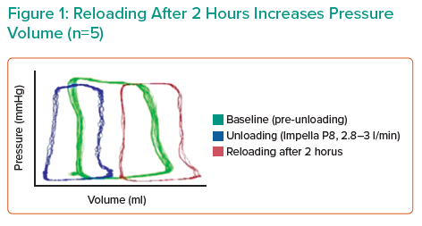
Mazurek R
Reloading After 2 Hours Increases Pressure Volume (n=5)
Citation: Interventional Cardiology Review 2021;16(Suppl 2):18–9.
https://doi.org/10.15420/icr.2021.S2

