Slide 1
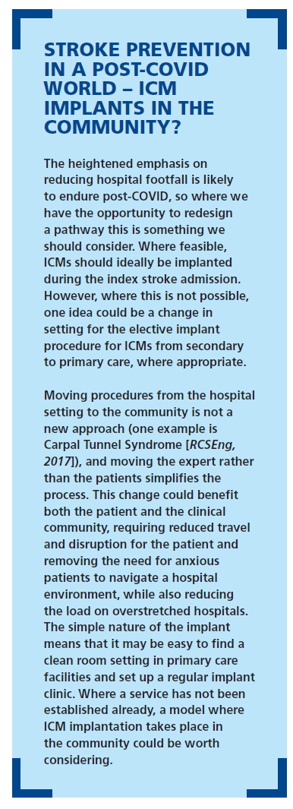
Baines N, Cunningham N, Chandratheva A, Fay M, Guyler P, Javaid Y, Kishore A, Patel N, Patwala A, Thakkar R
A Practical Guide to Setting up an ICM Service: Improving Detection of Atrial Fibrillation After Cryptogenic Stroke With Implantable Cardiac Monitors (ICMs)
Citation:

