Slide 1
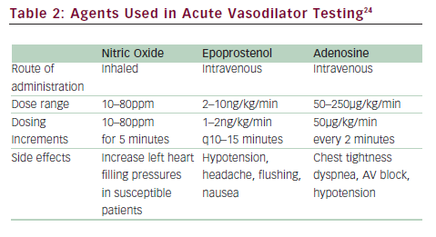
Park MH
Agents Used in Acute Vasodilator Testing
Citation: US Cardiology 2010;7(1):86–94
https://doi.org/10.15420/usc.2010.7.1.86

