Slide 1
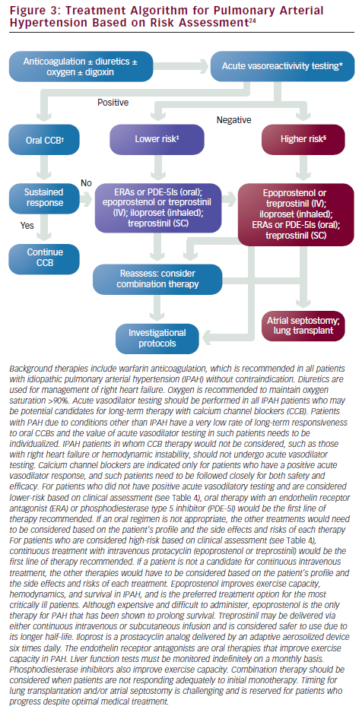
Park MH
Treatment Algorithm for Pulmonary Arterial Hypertension Based on Risk Assessment
Citation: US Cardiology 2010;7(1):86–94
https://doi.org/10.15420/usc.2010.7.1.86

