Slide 1
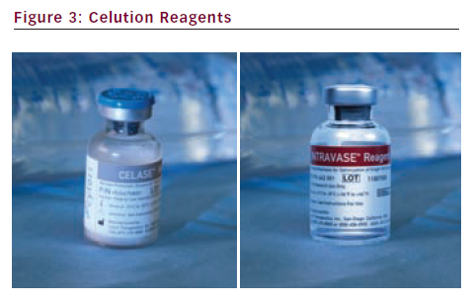
Sridhar P, Hedrick M, Baker T, Perin J, Conlan B
Celution Reagents
Citation: Interventional Cardiology 2012;7(2):77–80
https://doi.org/10.15420/icr.2012.7.2.77

