Slide 1
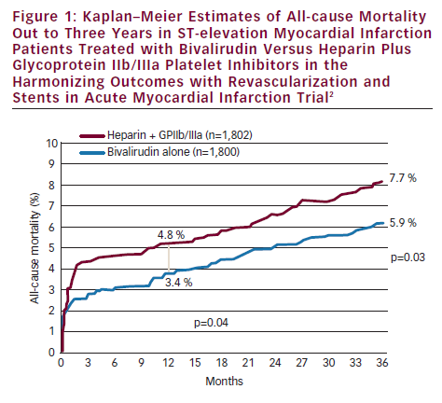
Brodie BR
Kaplan–Meier Estimates of All-cause Mortality Out to Three Years in ST-elevation Myocardial Infarction Patients Treated with Bivalirudin Versus Heparin Plus Glycoprotein IIb/IIIa Platelet Inhibitors in the Harmonizing Outcomes with Revascularization and Stents in Acute Myocardial Infarction Trial
Citation: Interventional Cardiology 2012;7(2):81–5
https://doi.org/10.15420/icr.2012.7.2.81

