Slide 1
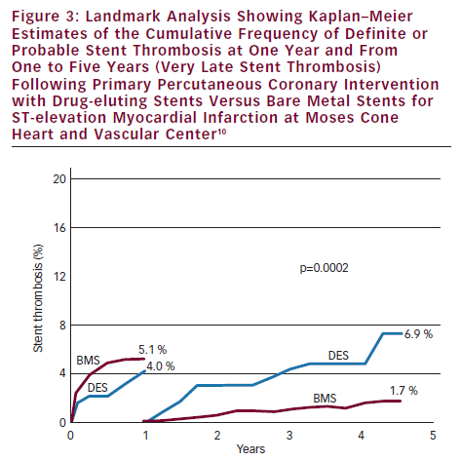
Brodie BR
Landmark Analysis Showing Kaplan–Meier Estimates of the Cumulative Frequency of Definite or Probable Stent Thrombosis at One Year and From One to Five Years (Very Late Stent Thrombosis) Following Primary Percutaneous Coronary Intervention with Drug-eluting Stents Versus Bare Metal Stents for ST-elevation Myocardial Infarction at Moses Cone Heart and Vascular Center1
Citation: Interventional Cardiology 2012;7(2):81–5
https://doi.org/10.15420/icr.2012.7.2.81

