Slide 1
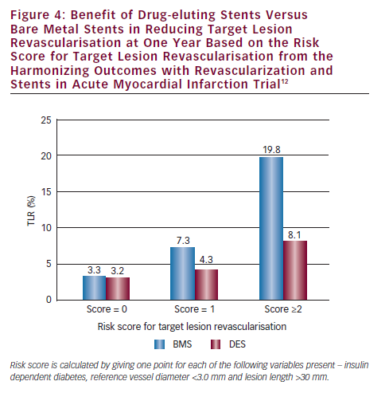
Brodie BR
Benefit of Drug-eluting Stents Versus Bare Metal Stents in Reducing Target Lesion Revascularisation at One Year Based on the Risk Score for Target Lesion Revascularisation from the Harmonizing Outcomes with Revascularization and Stents in Acute Myocardial Infarction Trial
Citation: Interventional Cardiology 2012;7(2):81–5
https://doi.org/10.15420/icr.2012.7.2.81

