Slide 1
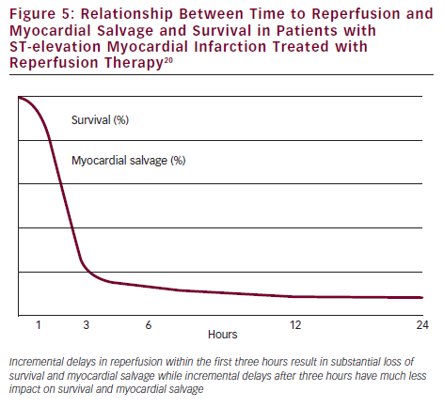
Brodie BR
Relationship Between Time to Reperfusion and Myocardial Salvage and Survival in Patients with ST-elevation Myocardial Infarction Treated with Reperfusion Therapy
Citation: Interventional Cardiology 2012;7(2):81–5
https://doi.org/10.15420/icr.2012.7.2.81

