Slide 1
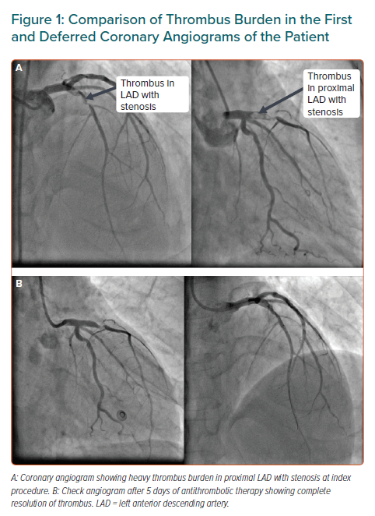
Pradhan A, Bhandari M, Vishwakarma P, Sethi R
Comparison of Thrombus Burden in the First and Deferred Coronary Angiograms of the Patient
Citation: European Cardiology Review 2021;16:e08.
https://doi.org/10.15420/ecr.2020.31

