Slide 1
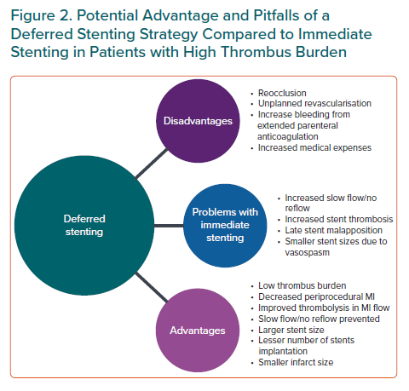
Pradhan A, Bhandari M, Vishwakarma P, Sethi R
Potential Advantage and Pitfalls of a Deferred Stenting Strategy Compared to Immediate Stenting in Patients with High Thrombus Burden
Citation: European Cardiology Review 2021;16:e08.
https://doi.org/10.15420/ecr.2020.31

