Slide 1
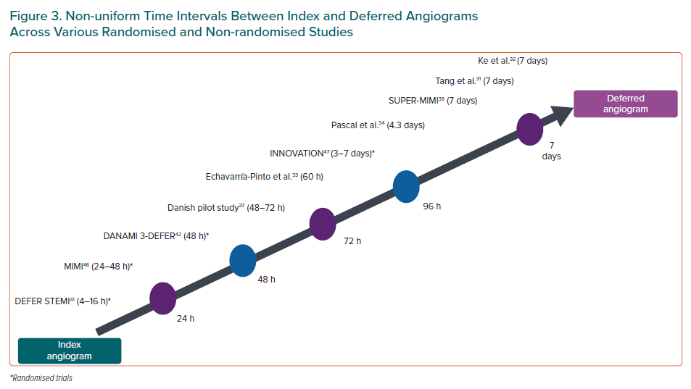
Pradhan A, Bhandari M, Vishwakarma P, Sethi R
Non-uniform Time Intervals Between Index and Deferred Angiograms Across Various Randomised and Non-randomised Studies
Citation: European Cardiology Review 2021;16:e08.
https://doi.org/10.15420/ecr.2020.31

