Slide 1
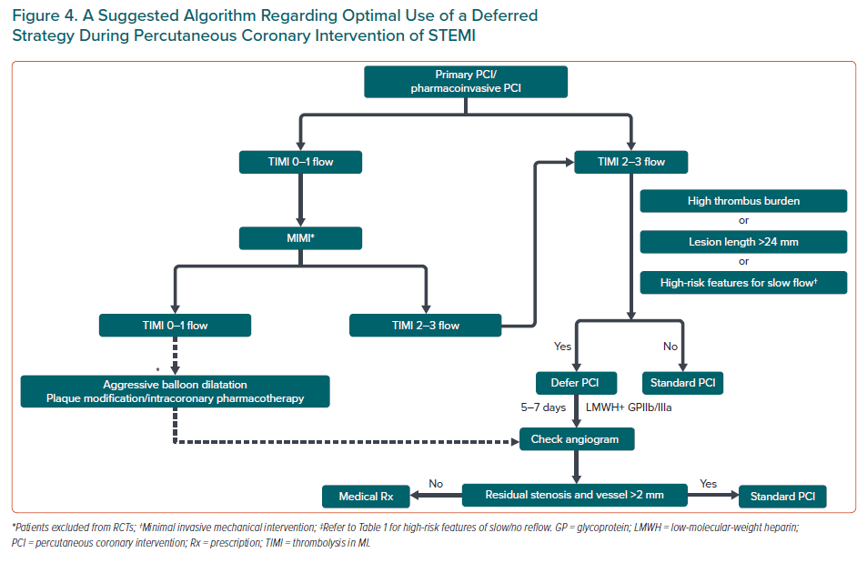
Pradhan A, Bhandari M, Vishwakarma P, Sethi R
A Suggested Algorithm Regarding Optimal Use of a Deferred Strategy During Percutaneous Coronary Intervention of STEMI
Citation: European Cardiology Review 2021;16:e08.
https://doi.org/10.15420/ecr.2020.31

