Slide 1
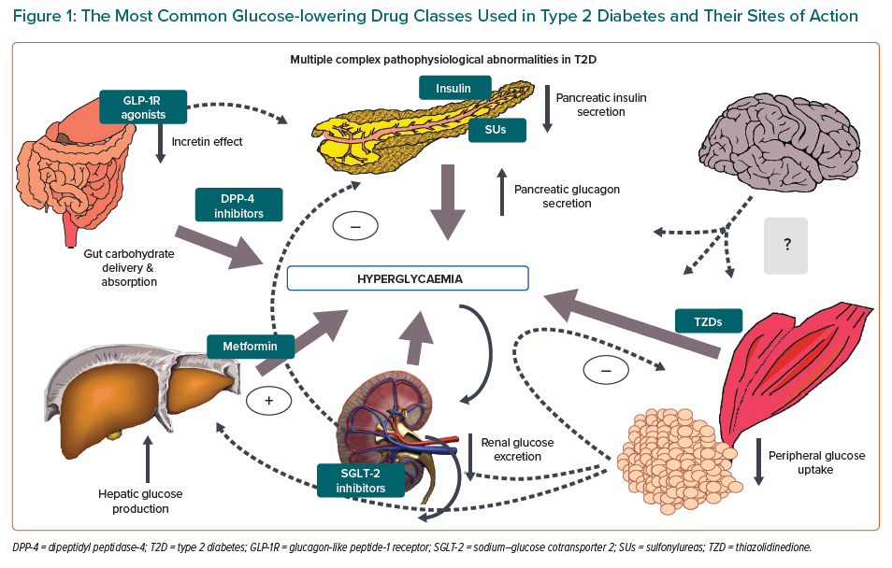
Ahmad T, Riello RJ, Inzucchi S
The Most Common Glucose-lowering Drug Classes Used in Type 2 Diabetes and Their Sites of Action
Citation: European Cardiology Review 2021;16:e11.
https://doi.org/10.15420/ecr.2020.01.R1

