Slide 1
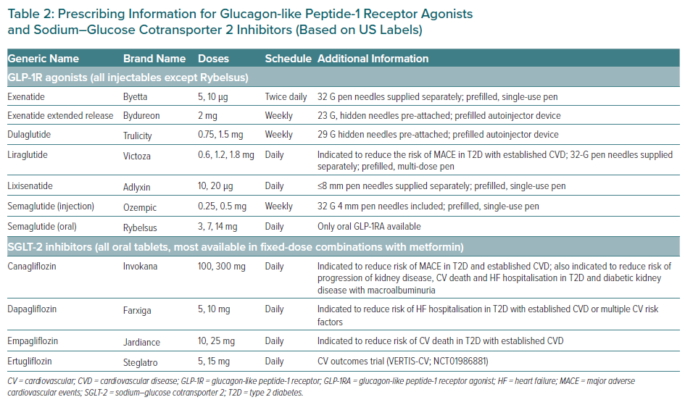
Ahmad T, Riello RJ, Inzucchi S
Prescribing Information for Glucagon-like Peptide-1 Receptor Agonists and Sodium–Glucose Cotransporter 2 Inhibitors (Based on US Labels)
Citation: European Cardiology Review 2021;16:e11.
https://doi.org/10.15420/ecr.2020.01.R1

