Slide 1
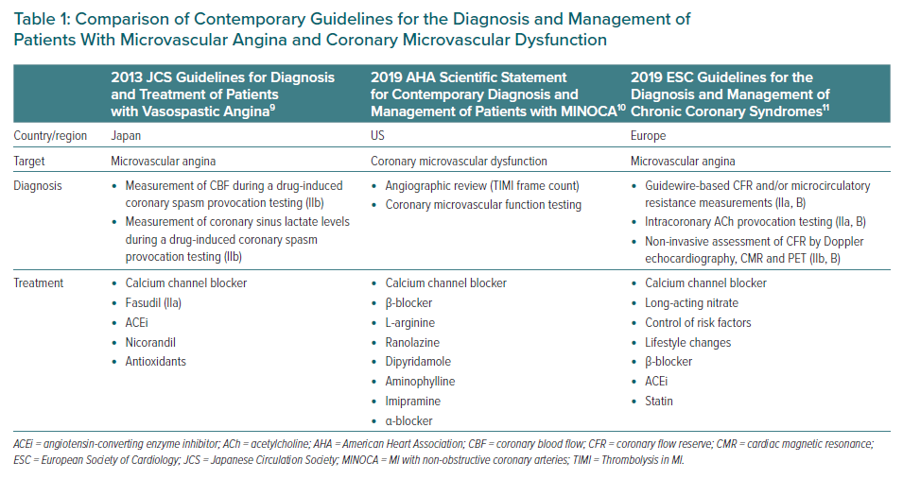
Godo S, Takahashi J, Yasuda S, Shimokawa H
Comparison of Contemporary Guidelines for the Diagnosis and Management of Patients With Microvascular Angina and Coronary Microvascular Dysfunction
Citation: European Cardiology Review 2021;16:e13.
https://doi.org/10.15420/ecr.2020.47

