Slide 1
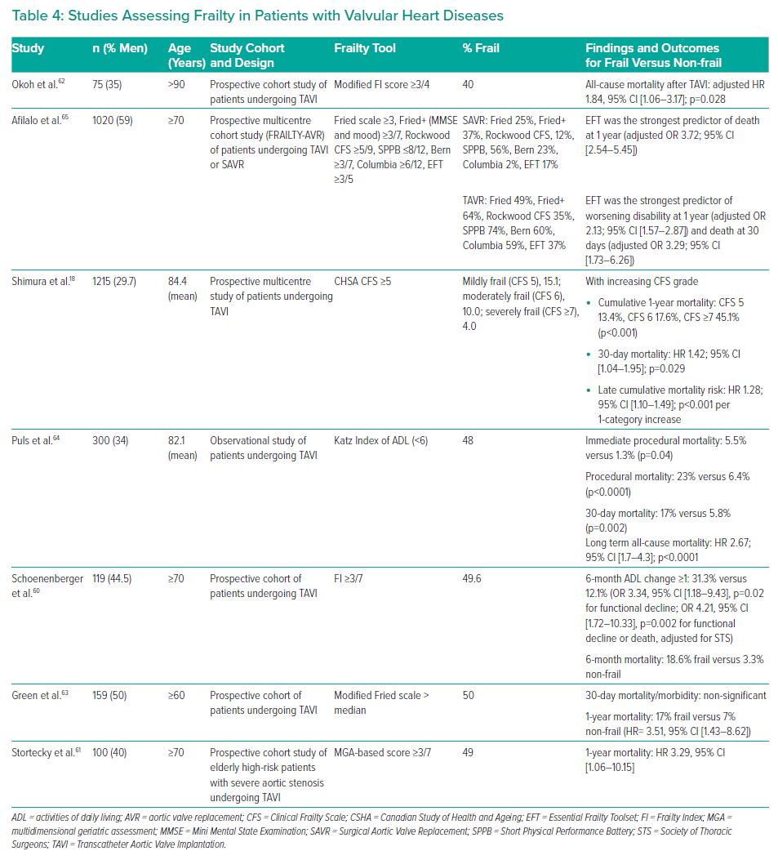
Cheong Chung KJN, Wilkinson C, Veerasamy M, Kunadian V
Studies Assessing Frailty in Patients with Valvular Heart Diseases
Citation: Interventional Cardiology Review 2021;16:e05.
https://doi.org/10.15420/icr.2020.18

