Slide 1
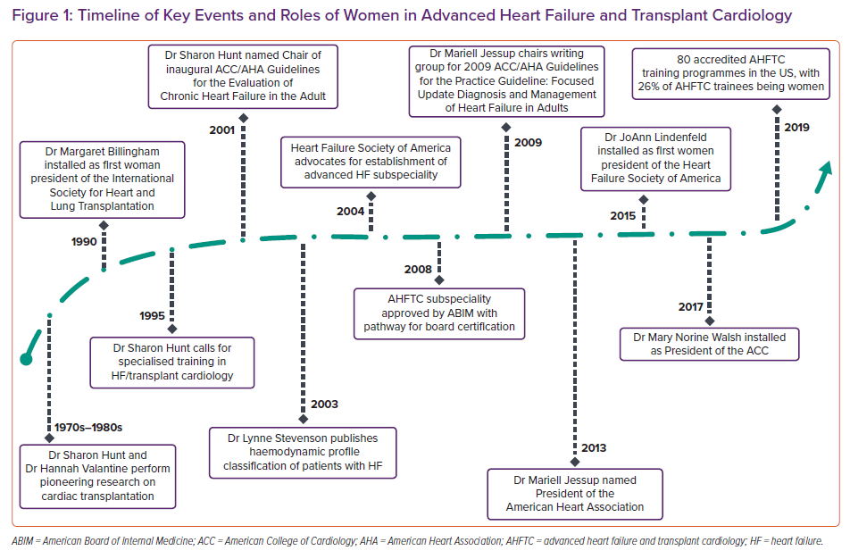
DeFilippis EM, Moayedi Y, Reza N
Timeline of Key Events and Roles of Women in Advanced Heart Failure and Transplant Cardiology
Citation: Cardiac Failure Review 2021;7:e05.
https://doi.org/10.15420/cfr.2020.31

