Slide 1
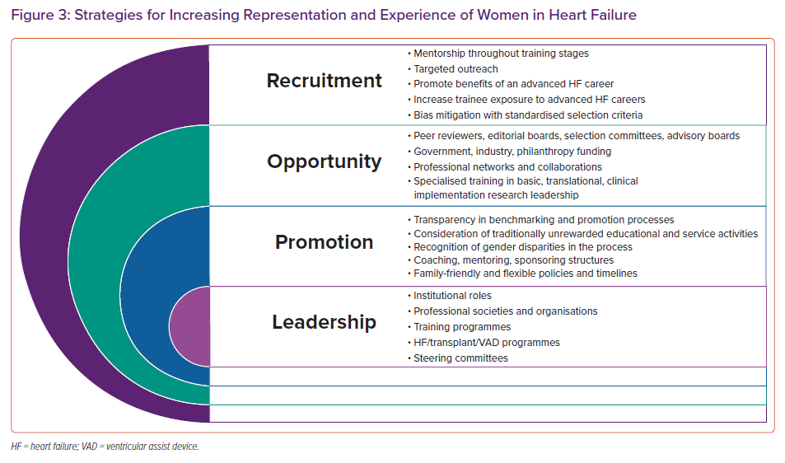
DeFilippis EM, Moayedi Y, Reza N
Strategies for Increasing Representation and Experience of Women in Heart Failure
Citation: Cardiac Failure Review 2021;7:e05.
https://doi.org/10.15420/cfr.2020.31

