Slide 1
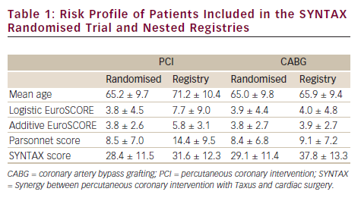
Head SJ, Bogers AJ, Kappetein AP
Risk Profile of Patients Included in the SYNTAX Randomised Trial and Nested Registries
Citation: Interventional Cardiology 2012:7(2):91-4
https://doi.org/10.15420/icr.2012.7.2.91

