Slide 1
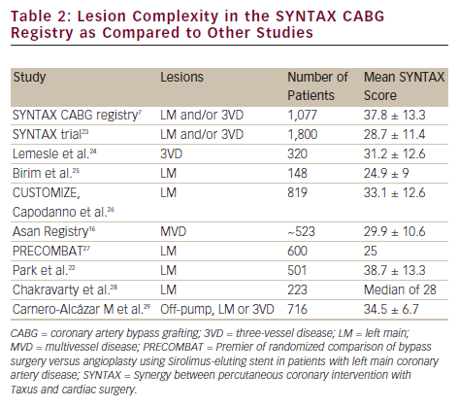
Head SJ, Bogers AJ, Kappetein AP
Lesion Complexity in the SYNTAX CABG Registry as Compared to Other Studies
Citation: Interventional Cardiology 2012:7(2):91-4
https://doi.org/10.15420/icr.2012.7.2.91

