Slide 1
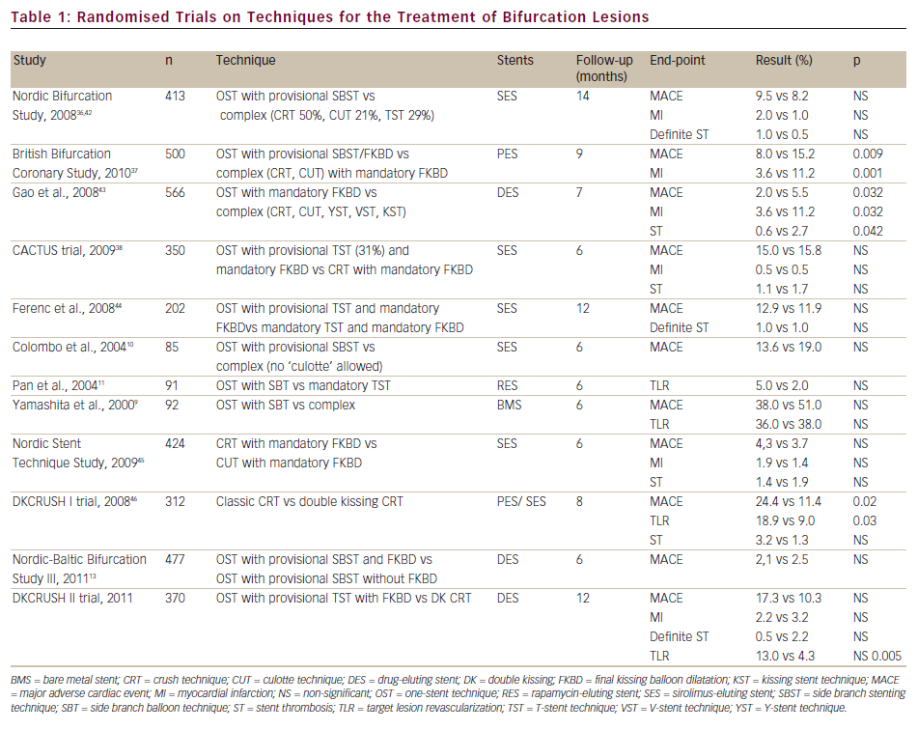
Narbute I, Jegere S, Kumsars I, Juhnevica D, Knipse A, Erglis A
Randomised Trials on Techniques for the Treatment of Bifurcation Lesions
Citation: Interventional Cardiology 2012;7(2):95–9
https://doi.org/10.15420/icr.2012.7.2.95

