Slide 1

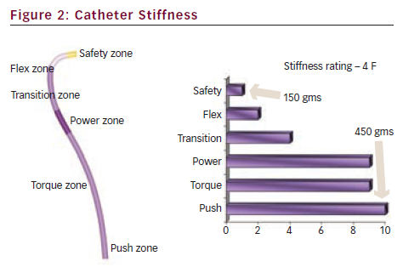
Ali R, Greenbaum AB, Kugelmass AD
Catheter Stiffness
Citation: Interventional Cardiology 2012;7(2):100–3
https://doi.org/10.15420/icr.2012.7.2.100

