Slide 1
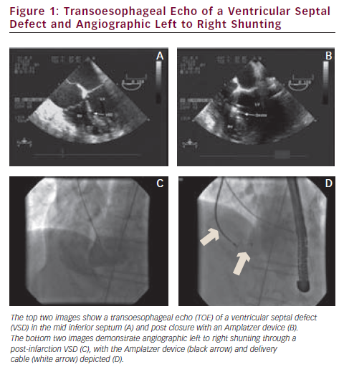
Glenie T, Ruygrok P
Transoesophageal Echo of a Ventricular Septal Defect and Angiographic Left to Right Shunting
Citation: Interventional Cardiology 2012;7(2):104–7
https://doi.org/10.15420/icr.2012.7.2.104

