Slide 1
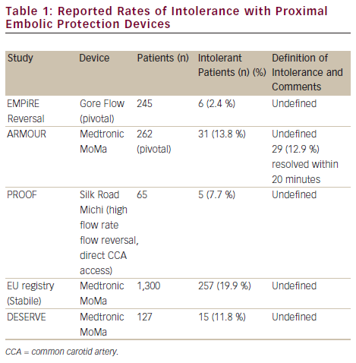
Kovacs F, Macdonald S
Reported Rates of Intolerance with Proximal Embolic Protection Devices
Citation: Interventional Cardiology 2012;7(2):115–9
https://doi.org/10.15420/icr.2012.7.2.115

