Slide 1
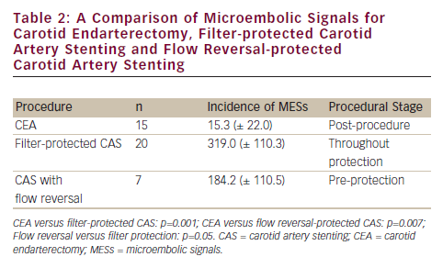
Kovacs F, Macdonald S
A Comparison of Microembolic Signals for Carotid Endarterectomy, Filter-protected Carotid Artery Stenting and Flow Reversal-protected Carotid Artery Stenting
Citation: Interventional Cardiology 2012;7(2):115–9
https://doi.org/10.15420/icr.2012.7.2.115

