Slide 1
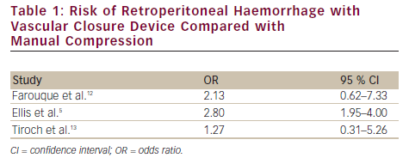
Holland BH, Applegate RJ
Risk of Retroperitoneal Haemorrhage with Vascular Closure Device Compared with Manual Compression
Citation: Interventional Cardiology 2012;7(2):108–14
https://doi.org/10.15420/icr.2012.7.2.108

