Slide 1
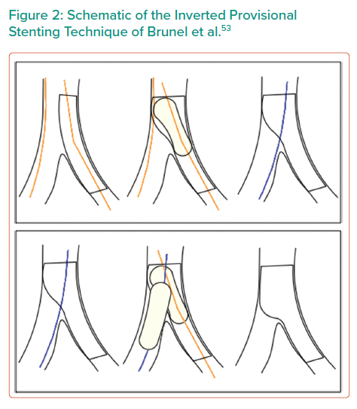
Suleiman S, Coughlan J, Touma G, Szirt R
Schematic of the Inverted Provisional Stenting Technique of Brunel et al
Citation: Interventional Cardiology Review 2021;16:e06.
https://doi.org/10.15420/icr.2020.30

