Slide 1
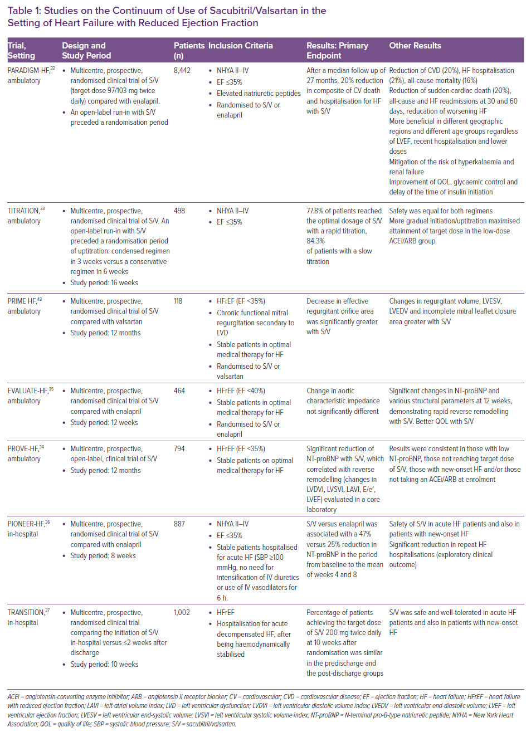
Gori M, Januzzi JL, D'Elia E, Lorini FL, Senni M
Studies on the Continuum of Use of Sacubitril/Valsartan in the Setting of Heart Failure with Reduced Ejection Fraction
Citation: Cardiac Failure Review 2021;7:e06.
https://doi.org/10.15420/cfr.2020.25

