Slide 1
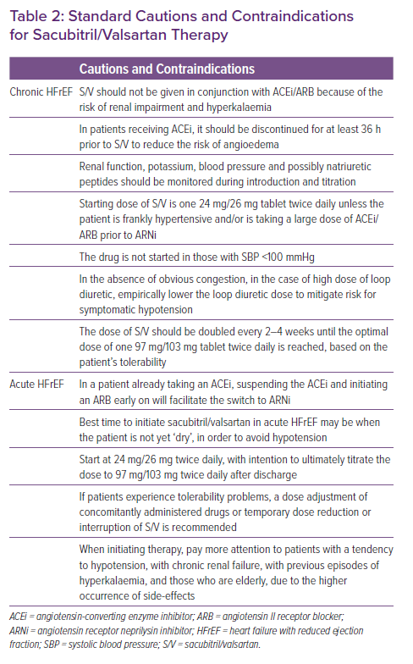
Gori M, Januzzi JL, D'Elia E, Lorini FL, Senni M
Standard Cautions and Contraindications for Sacubitril/Valsartan Therapy
Citation: Cardiac Failure Review 2021;7:e06.
https://doi.org/10.15420/cfr.2020.25

