Slide 1
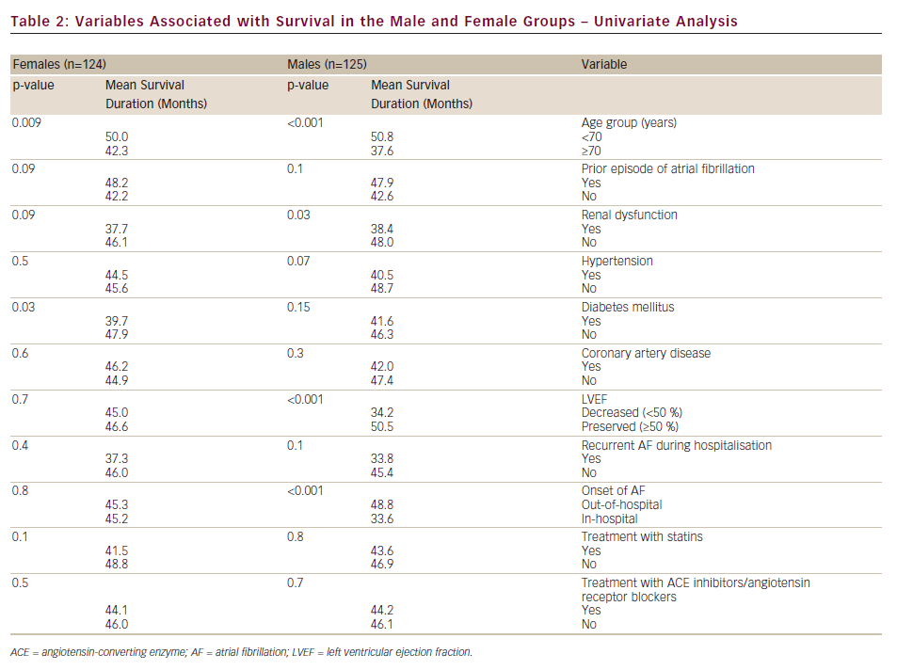
Shteinshnaider M, Almoznino-Sarafian D, Berman S, Tzur I, Cohen N, Gorelik O
Variables Associated with Survival in the Male and Female Groups – Univariate Analysis
Citation: European Cardiology 2012;8(3):152–7
https://doi.org/10.15420/ecr.2012.8.3.152

