Slide 1
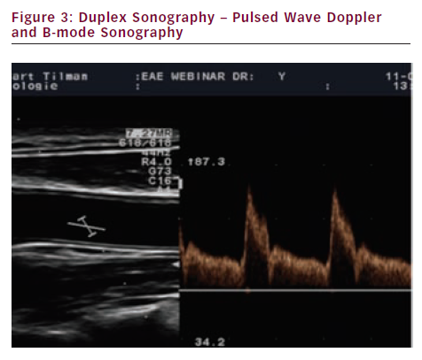
Sprynger M
Duplex Sonography – Pulsed Wave Doppler and B-mode Sonography
Citation: European Cardiology 2012;8(3):158–64
https://doi.org/10.15420/ecr.2012.8.3.158

