Slide 1

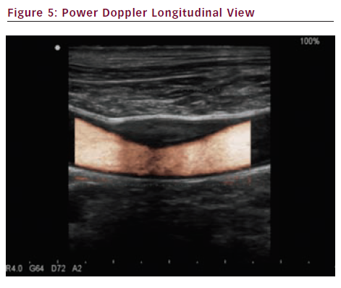
Sprynger M
Power Doppler Longitudinal View
Citation: European Cardiology 2012;8(3):158–64
https://doi.org/10.15420/ecr.2012.8.3.158

