Slide 1

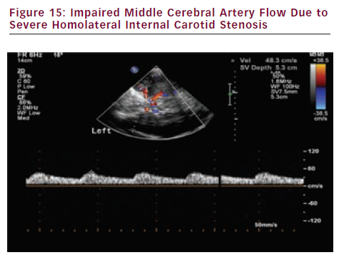
Sprynger M
Impaired Middle Cerebral Artery Flow Due to Severe Homolateral Internal Carotid Stenosis
Citation: European Cardiology 2012;8(3):158–64
https://doi.org/10.15420/ecr.2012.8.3.158

