Slide 1
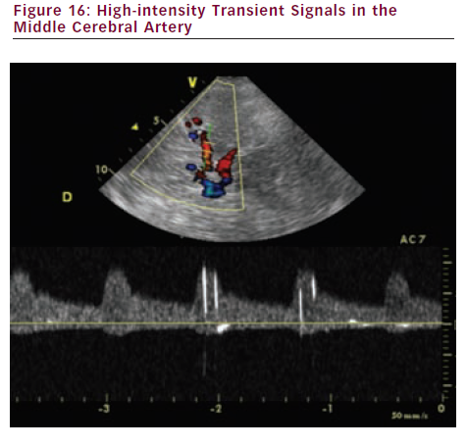
Sprynger M
High-intensity Transient Signals in the Middle Cerebral Artery
Citation: European Cardiology 2012;8(3):158–64
https://doi.org/10.15420/ecr.2012.8.3.158

