Slide 1
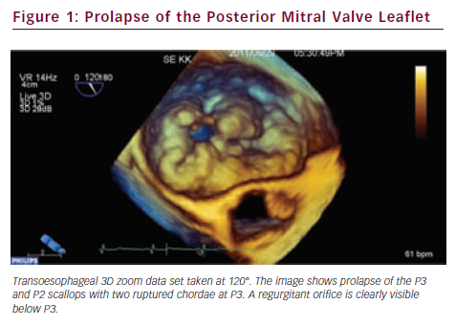
Apor A, Nagy A, Nagy A, Merkely B
Prolapse of the Posterior Mitral Valve Leaflet
Citation: European Cardiology 2012;8(3):165–70
https://doi.org/10.15420/ecr.2012.8.3.165

