Slide 1
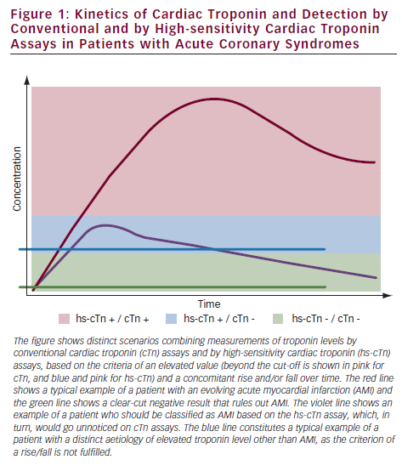
Klingenberg R, Matter CM, Wyss C, Hof D, von Eckardstein A, Lüscher TF
Kinetics of Cardiac Troponin and Detection by Conventional and by High-sensitivity Cardiac Troponin Assays in Patients with Acute Coronary Syndromes
Citation: European Cardiology 2012;8(3):181-5
https://doi.org/10.15420/ecr.2012.8.3.181

