Slide 1
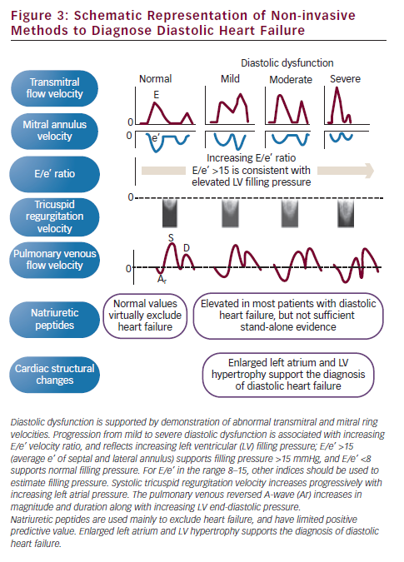
Smiseth OA, Opdahl A, Boe E, Skulstad H
Schematic Representation of Non-invasive Methods to Diagnose Diastolic Heart Failure
Citation: European Cardiology 2012;8(3):186–91
https://doi.org/10.15420/ecr.2012.8.3.186

