Slide 1
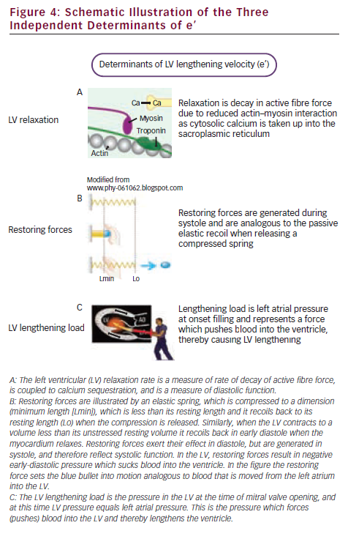
Smiseth OA, Opdahl A, Boe E, Skulstad H
Schematic Illustration of the Three Independent Determinants of e’
Citation: European Cardiology 2012;8(3):186–91
https://doi.org/10.15420/ecr.2012.8.3.186

